Slide 1
Web Harvesting
By Fasaah Mazin K

Slide 2
Our Team
Ayush Lunkad
Fasaah Mazin
Abhinav Raj
MEMBER
RA2111027010166
LEADER
RA2111027010167
MEMBER
RA2111027010162
Notes:
https://unsplash.com/photos/F3Y8BfZn4jo
https://unsplash.com/photos/a0EQFTH4ZfA
https://unsplash.com/photos/mEZ3PoFGs_k
https://unsplash.com/photos/DItYlc26zVI

Slide 3
Project Description
A web harvester also known as scraper is a type of software that automates the process of extracting data from websites. It can be used to extract data from a single website or multiple websites. The data can be in the form of text, images, videos, or any other type of content.
Web scrapers are used to collect large amounts of data from the web, which can then be used to analyze trends, build databases, and automate tasks.

Slide 4
Problem:
Opportunity:
Difficulty in finding the needed data in web when it’s overflowing with data.
It can save time and money.
It can also be used to gather data from multiple sources, which can then be used to analyze trends or build databases.
Web scrapers can also be used to automate tasks, such as monitoring prices or checking for new content.
Web scrapers can also be used to create new web pages, such as by scraping content from other websites and repurposing it for a new site.

Slide 5
History:
The history of web scraping dates back nearly to the time when the World Wide Web was born.
After the birth of the World Wide Web in 1989, the first web robot, World Wide Web Wanderer, was created in June 1993, which was intended only to measure the size of the web.
In 2000, the first Web API and API crawler were created. An API (Application Programming Interface) is an interface that makes it much easier to develop a program by providing the building blocks. In 2000, Salesforce and eBay launched their own API, with which programmers could access and download some of the data available to the public. Since then, many websites offer web APIs for people to access their public database.
Notes:
https://unsplash.com/photos/F3Y8BfZn4jo

Slide 6
Limitation:
Limited adoption and usage of the scraper by the people
Resistance to change and reluctance to adopt new technologies
Potential security risks or vulnerabilities that may compromise the personal information of users.
Web scraping can’t be done on all websites.
If there is too much information there is a possibility that it can crash.

Slide 7
Approach:
● A team with relevant skills and experience in development, design and project management.
● Funding for development, maintenance, and promotion.
● Access to the needed information for creating

Slide 8
Benefits:
1. Price Monitoring
Web Scraping can be used by companies to scrap the product data for their products and competing products as well to see how it impacts their pricing strategies. Companies can use this data to fix the optimal pricing for their products so that they can obtain maximum revenue.
2. Market Research
Web scraping can be used for market research by companies. High-quality web scraped data obtained in large volumes can be very helpful for companies in analyzing consumer trends and understanding which direction the company should move in the future.

Slide 9
3. News Monitoring
Web scraping news sites can provide detailed reports on the current news to a company. This is even more essential for companies that are frequently in the news or that depend on daily news for their day-to-day functioning. After all, news reports can make or break a company in a single day!
4. Sentiment Analysis
If companies want to understand the general sentiment for their products among their consumers, then Sentiment Analysis is a must. Companies can use web scraping to collect data from social media websites such as Facebook and Twitter as to what the general sentiment about their products is. This will help them in creating products that people desire and moving ahead of their competition.

Slide 10
Selection of Methodology:
The particular requirements and limitations of the project determine whether to use the Waterfall or Agile technique.
Software development using the waterfall process is sequential and linear, meaning that each stage must be finished before moving on to the next. For projects with clearly defined requirements and an awareness of the end purpose, this style works best.
Contrarily, agile methodology is a flexible and iterative strategy that places a premium on collaboration, frequent adaptability, and continuous improvement. Projects with changing requirements, a need for rapid feedback, and a need for quick, frequent delivery are best suited for agile approach.

Slide 11
The Waterfall methodology may be more suitable for this project if the criteria and goals are clearly stated and do not change frequently. However, the Agile technique may be more appropriate if the requirements are anticipated to change regularly or if frequent user feedback is required.
User Centred Approach
Agile technique places the user at the centre of the development process with an emphasis on understanding their needs and providing value rapidly. This user-centered approach is essential for a student-teacher app to make sure it fits the demands of its users and adds value.

Slide 12
Flexibility
Agile methodologies are malleable and flexible, allowing for the incorporation of changing requirements and expectations into the development process. This is crucial for a student-teacher app whose requirements might vary in response to student and instructor feedback.
Collaboration
Collaboration is emphasised by the agile process, which also encourages regular check-ins and communication amongst all stakeholders. For a student-teacher app, where both students and teachers will be using the app and offering feedback, this is especially crucial.

Slide 13
Continuous improvement
Agile methodology places a high value on iteration and continuous improvement, enabling the team to continuously polish and improve the app in response to user feedback. This is essential for a student-teacher app since the demands of users can change over time, and the software needs to adapt.
Quick and frequent deliveries
Quick and frequent deployments are prioritised by the agile methodology, enabling the team to give customers access to tiny, functional portions of the app early in the development process and collect user feedback. By doing so, the danger of creating something that doesn't satisfy user wants is reduced, and the likelihood of success is raised.

Slide 14
Conclusion:
In conclusion, this project is a strong fit for the Agile methodology since it offers a user-centered, adaptable, collaborative, and constantly evolving approach to development.

Slide 15
SYSTEM REQUIREMENTS
OS: WINDOWS 10 OR HIGHER
PROCESSOR: 2.6 GHz OR HIGHER
RAM: MINIMUM 4GB
DISPLAY: RESOLUTION OF 720P OR HIGHER
HARD DISK: MINIMUM FREE SPACE

Slide 16
FUNCTIONAL REQUIREMENTS
DATA DISCOVERY
DATA EXTRACTION
EXTRACTION SCALE
DATA OUTPUT

Slide 17
NON FUNCTIONAL REQUIREMENTS
1.ACCURACY
2.SPEED
3.RELIABILITY
4.USABILITY
5.COMPATIBILITY

Slide 18
PROJECT MANAGEMENT PLAN
FOCUS AREAS | DESCRIPTIONS
INTEGRATION MANAGEMENT | Project Team Structure, Roles & Responsibilities of Team, Project Closure
2. SCOPE MANAGEMENT | The website will be accessible to everyone on the web and will be easy to use
3. SCHEDULE MANAGEMENT | Project Start Date: 12/01/2023 Project End Date: June 2023 (estimated) Milestones: Website Design Completion,Website Development Completion,Website Testing Completion, Website Launch, Website Maintenance

Slide 19
PROJECT MANAGEMENT PLAN
4. COST MANAGEMENT | Budget: Rupees - 1,00,000 - 2,00,000 Resource Requirements: Server Hosting, website Development Tools, Mobile and Web Development Platforms, Quality Assurance and Testing Tools.
5. QUALITY MANAGEMENT | Quality Assurance, Quality Control
6. RESOURCE MANAGEMENT | Estimate and Manage the need, Finance: Budget Required
7. STAKEHOLDER | Identifying, Analyzing, Engaging Stakeholders

Slide 20
PROJECT MANAGEMENT PLAN
8. COMMUNICATION MANAGEMENT | Determine communication requirements, roles and responsibilities, tools and techniques.
9. RISK MANAGEMENT | Identifying, analysing, and prioritizing project risks
10. PROCUREMENT MANAGEMENT | Adhering to organization procurement process

Slide 21
EFFORT AND COST ESTIMATION
TASK | Effort (in person-hours) | Cost (per hour) | Total Cost
Project Planning | 100 | ₹1,000 | ₹1,00,000
Requirements Gathering | 50 | ₹500 | ₹25,000
UI/UX Design | 20 | ₹400 | ₹8,000
Software Development | 70 | ₹700 | ₹49,000
Quality Assurance | 15 | ₹200 | ₹3,000
Deployment and Maintenance | 50 | ₹400 | ₹20,000
Total: | 375 | ₹3,200 | ₹2,05,000

Slide 22
WORK BREAKDOWN STRUCTURE
1) Project Initiation
1.1. Define project scope and objectives
1.2. Identify stakeholders and their roles
1.3. Form project team
1.4. Develop project plan and schedule
1.5. Obtain necessary resources
2) Requirements Gathering
2.1. Analyze user needs and preferences
2.2. Identify required features and functions
2.3. Determine technical requirements

Slide 23
WORK BREAKDOWN STRUCTURE
3) UI/UX Design
3.1. Develop website and prototypes
3.2. Create visual design elements
3.3. Incorporate branding elements
3.4. Conduct user testing and feedback
3.5. Finalize UI/UX design
4) Software Development
4.1. Develop server-side functionality
4.2. Develop client-side functionality
4.3. Integrate server and client-side functionality
4.4. Develop backend database

Slide 24
WORK BREAKDOWN STRUCTURE
5) Quality Assurance
5.1. Develop test cases and test plans
5.2. Conduct functional and usability testing
5.3. Identify and resolve bugs and issues
5.4. Conduct regression testing
5.5. Finalize testing and bug resolution
6) Deployment and Maintenance
6.1. Prepare for deployment
6.2. Conduct system testing and validation
6.3. Roll out website to users
6.4. Conduct user training and support
6.5. Maintain and update website as needed

Slide 25
Risk | Impact | Likelihood | Severity | Mitigation
Delay in obtaining necessary resources | High | Medium | High | Identify alternative sources for resources, communicate with stakeholders regarding delays, adjust project timeline as necessary
Incomplete or inaccurate requirements gathering | High | High | High | Conduct thorough research, utilize multiple data collection methods
Technical challenges during software development | High | Medium | High | Hire experienced developers, utilize agile development methods, conduct regular code reviews and testing
Security vulnerabilities in website | High | Low | High | Implement robust security measures, conduct regular security audits and testing, stay up-to-date with industry security standards
User adoption and engagement challenges | Medium | High | Medium | Conduct user testing and feedback throughout development, develop marketing and outreach strategies.

Slide 26
Budget overruns or financial constraints | High | Medium | High | Develop a detailed budget and cost estimation plan, monitor expenses closely, identify cost-saving measures, adjust project scope or timeline as necessary
Stakeholder conflicts or miscommunications | Medium | Medium | Medium | Clearly define stakeholder roles and responsibilities, establish open lines of communication, conduct regular status meetings
Legal or regulatory compliance issues | High | Low | High | Conduct thorough research and adhere to relevant laws and regulations, consult with legal professionals as necessary, implement necessary compliance measures.

Slide 27
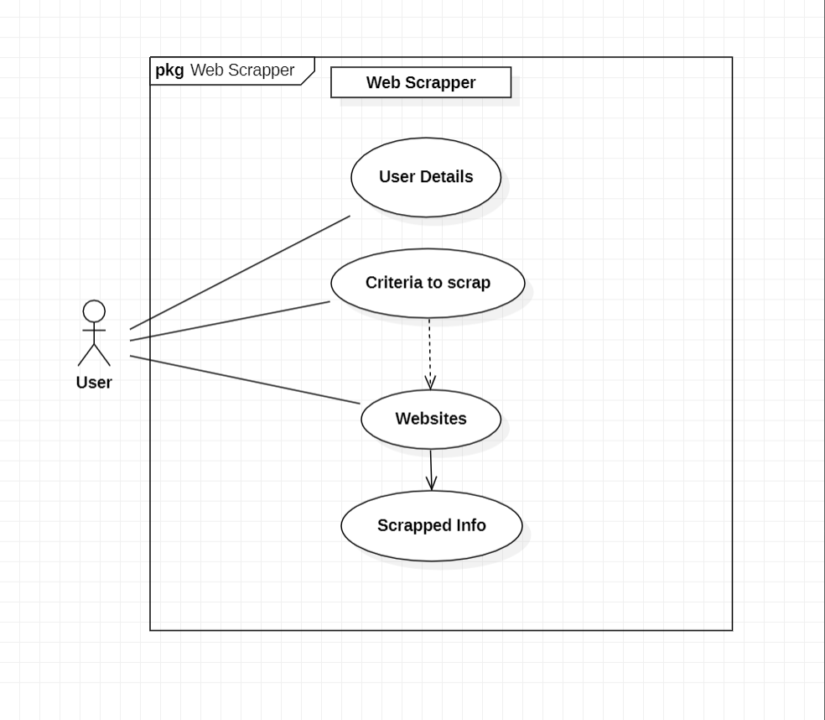
USE CASE DIAGRAM

Slide 28
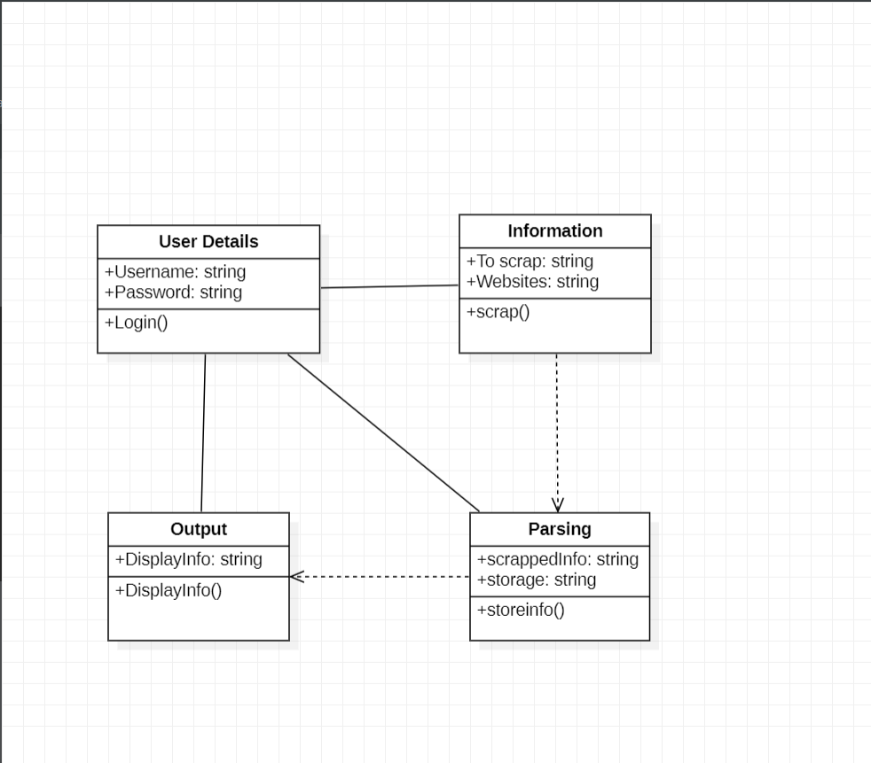
CLASS DIAGRAM

Slide 29
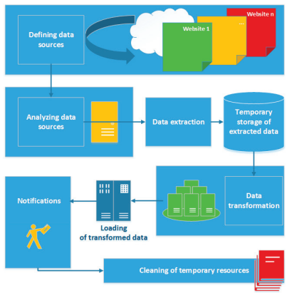
SYSTEM ARCHITECTURE DIAGRAM

Slide 30
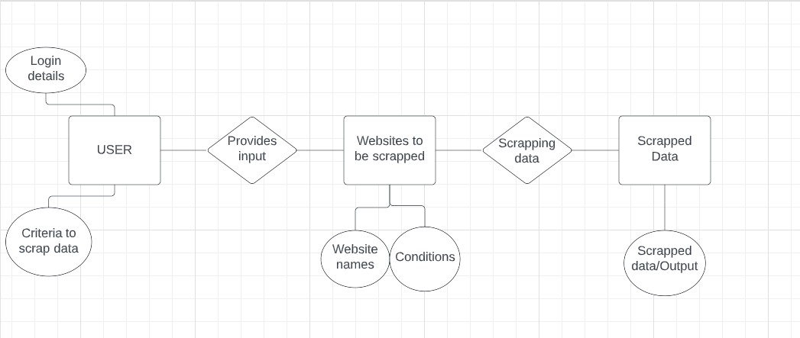
ENTITY RELATIONSHIP DIAGRAM

Slide 31
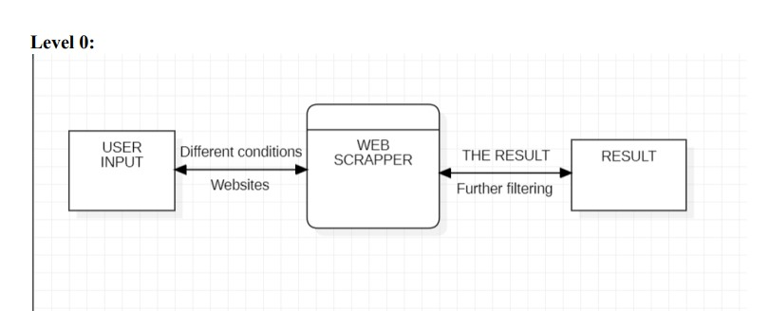
Data Flow Diagram

Slide 32
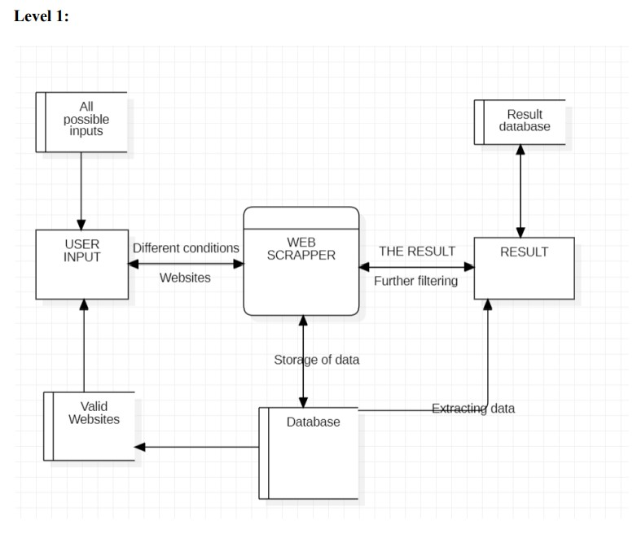

Slide 33
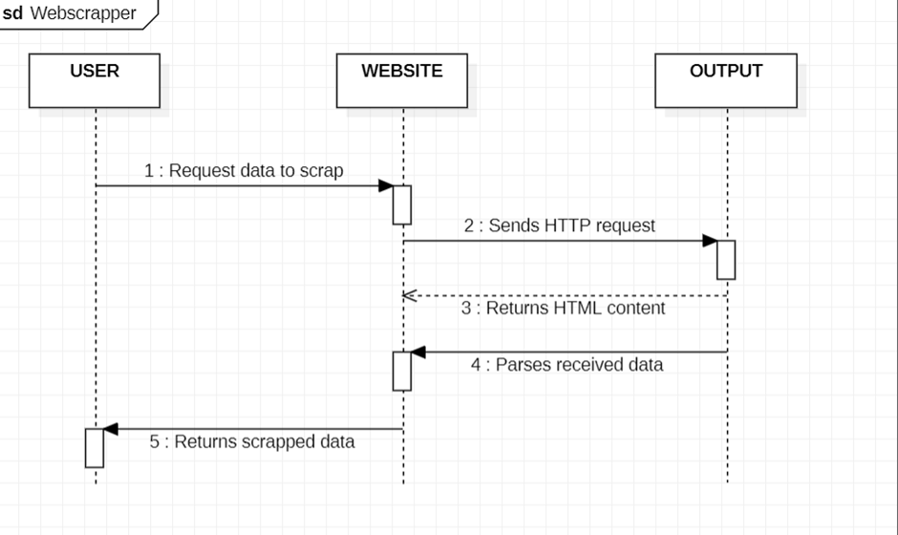
Sequence Diagram

Slide 35
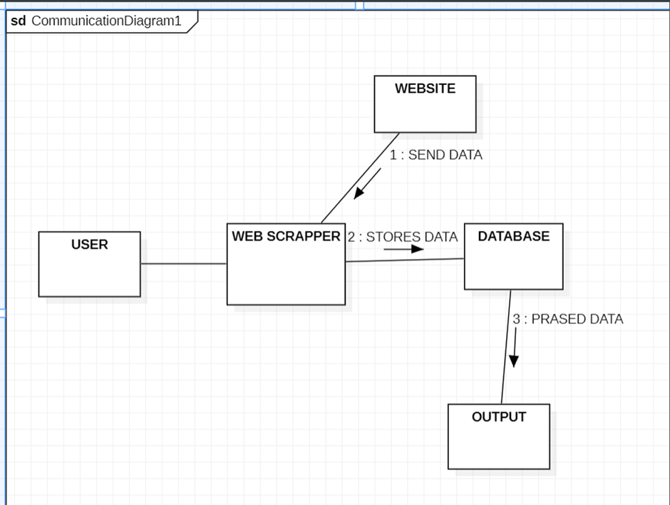
Communication Diagram

Slide 36
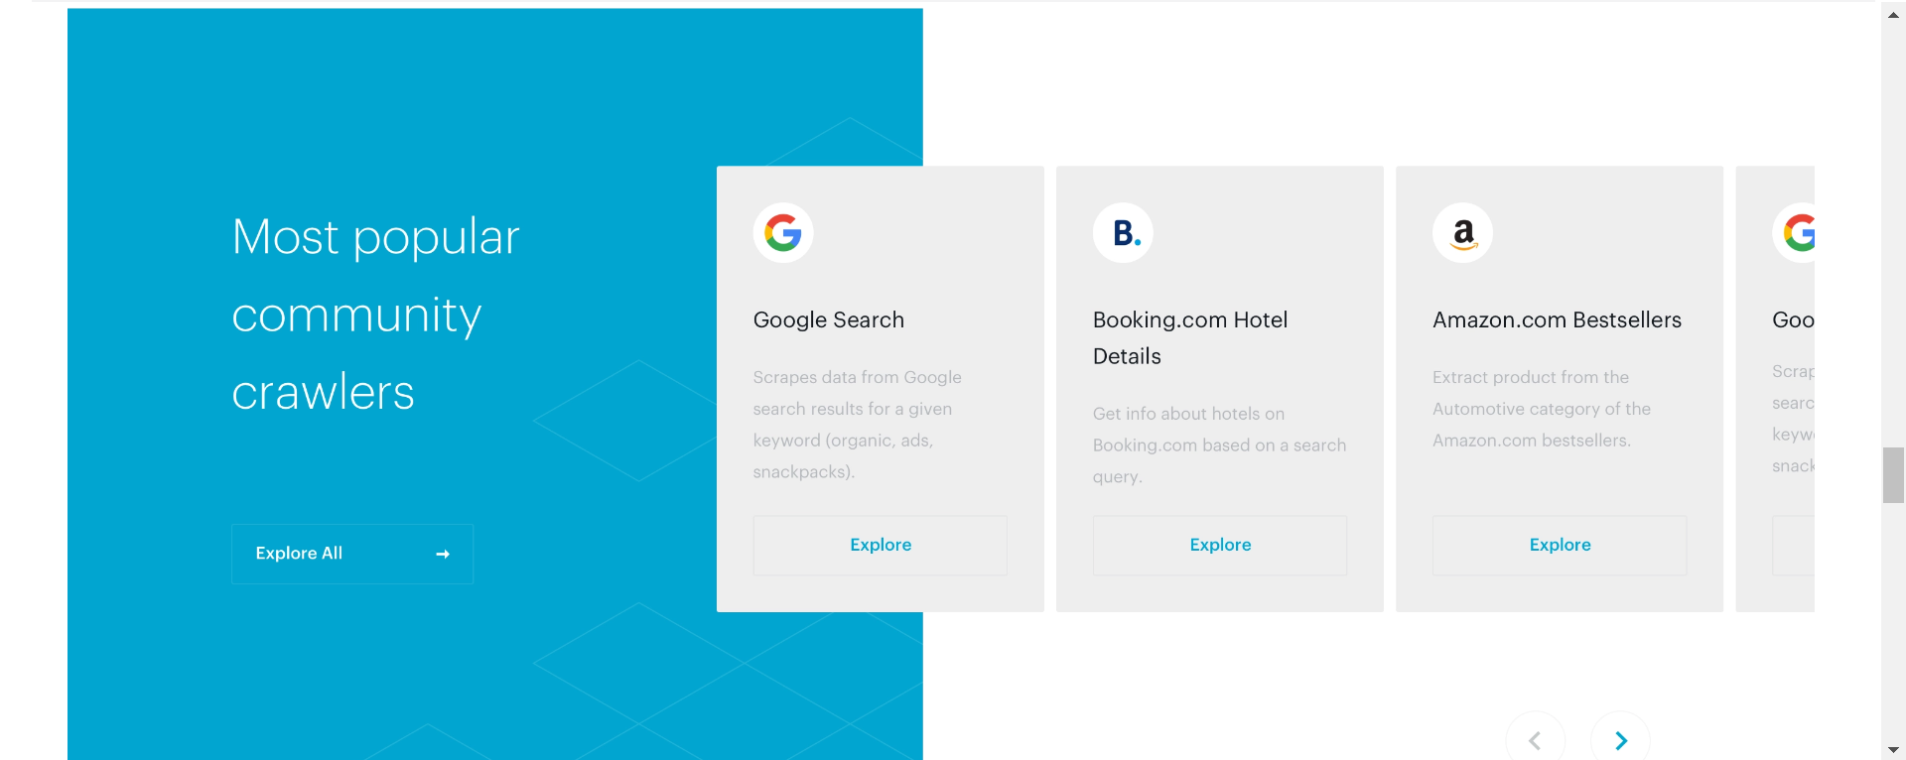
UI DESIGN:

Slide 37
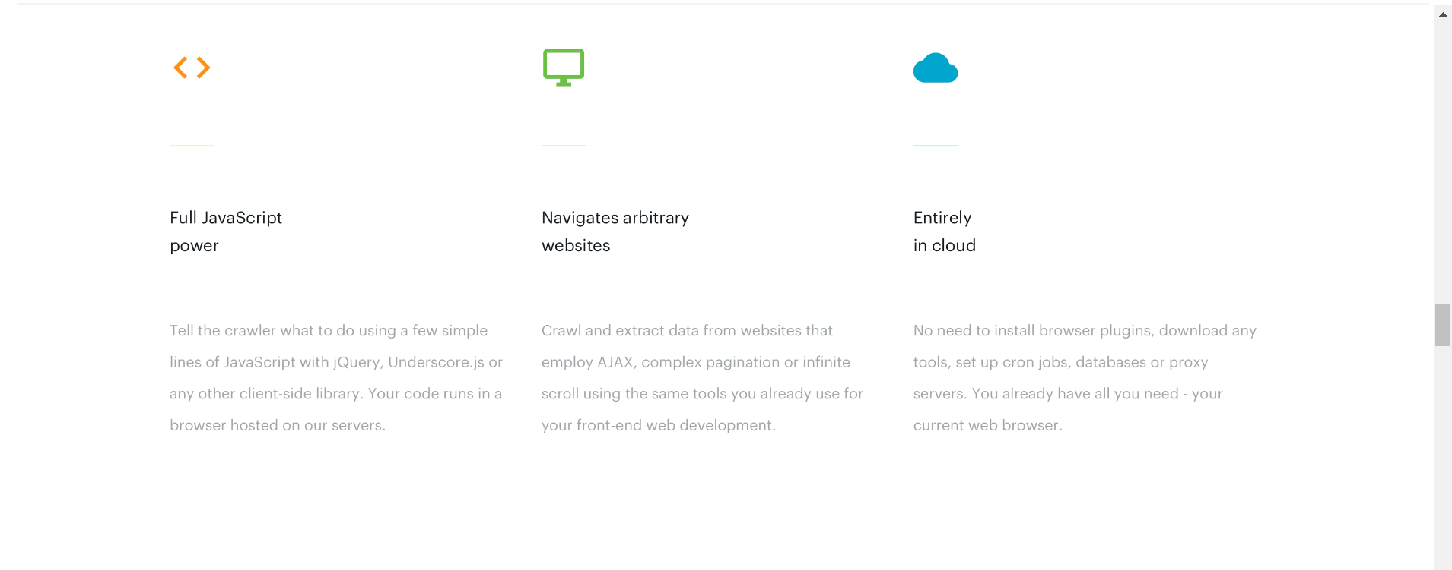

Slide 38
Manual test case report:
Category | Progress Against Plan | Status
Functional Testing | Amber | In Progress
Non-Functional Testing | Amber | In Progress

Slide 39
Summary of current progress:
Functional | Test Case Coverage (%) | Status
Login Details | 20% | Completed
Websites and criteria | 40% | Completed
Testing the functionalities of all the buttons | 20% | In Progress

Slide 40
Non-Functional | Test Case Coverage (%) | Status
Check whether the interface is proper in various other browsers. | 20% | In Progress (Some functionalities still need to be checked.)

Slide 41
Present Obstacles to proceed further:
● There is a risk of change in the user interface and malfunctioning of minute
functionalities of the web browser.
● Though they cannot be notified by a common user, we intend to provide a seamless
experience to a technical user too, thus there is still a need to check the UI of web
browsers with a few more kinds of systems and PCs.
Help from stakeholders:
● We expect a little more time to check the smooth working of the browser.
● We also expect access to more kinds of systems asked for as early as possible which
are in good working condition.

Slide 42
THANK YOU

